Slide 1
High-Frequency Trading Module 1: The Business of HFT
Slides to accompany High-Frequency Trading: A Practical Guide to Algorithmic Strategies and Trading Systems, 2nd edition, by Irene Aldridge

Slide 2
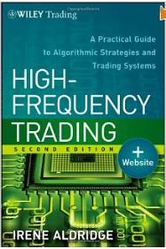
Required Text
High-Frequency Trading: A Practical Guide to Algorithmic Strategies and Trading Systems
2nd Edition
Wiley, 2013
ISBN: 978-1118343500

Slide 3
Course Structure
The business of HFT
Key components of successful HFT
Technology
Models
Advanced Models
Self-learning Models
Implementation of HFT
Risk Management of Trading
Risk Management of Systems
Optimal Execution

Slide 4
The business of HFT
Outline:
History of trading
What is HFT?
Realities of modern trading

Slide 5
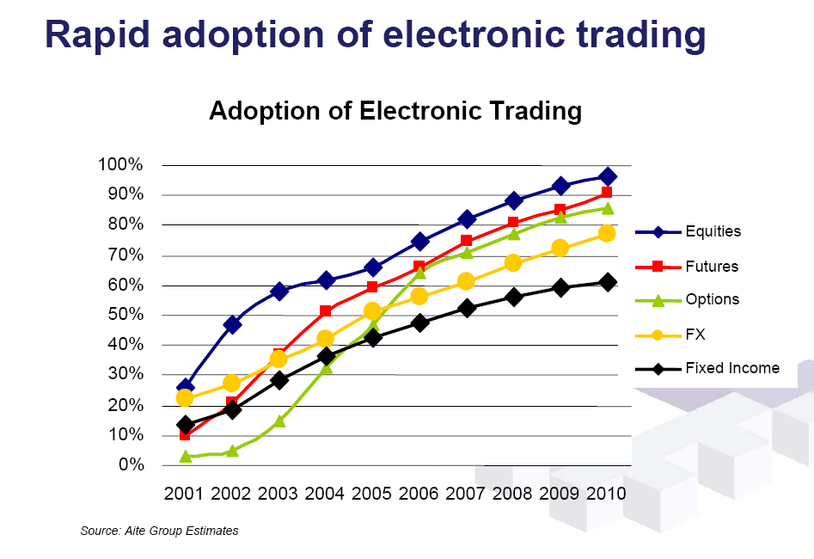
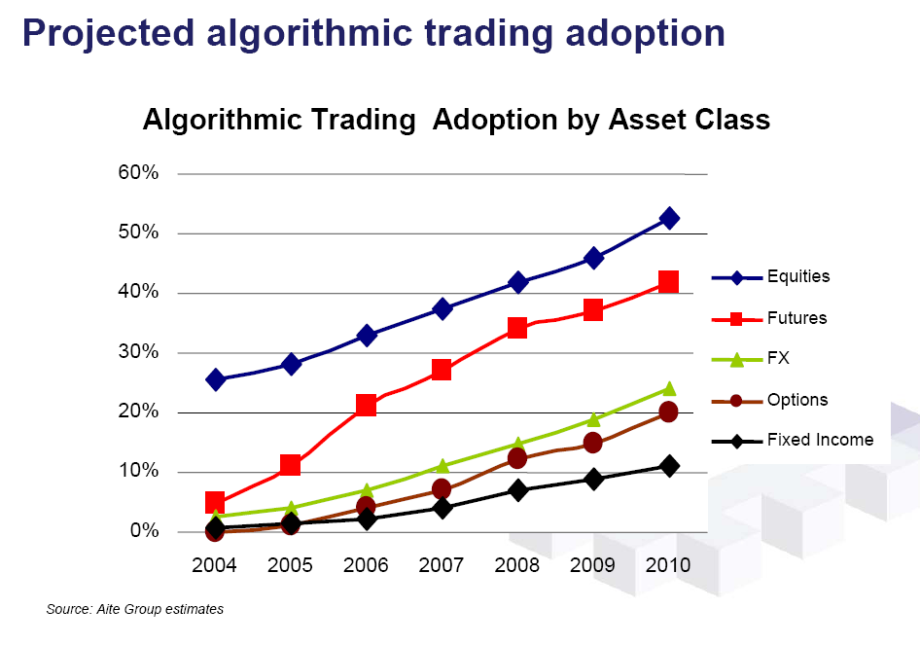
1. Emergence of algo trading
Evolution of trading
Adoption of electronic trading
Open outcry method of trading
Virtual trading floor electronically
Disintermediation
Stock market booms and crashes
Shorter settlement cycles
Wall Street decimalization
Standardization using FIX protocol
Program trading
Digitalization of trading – Algorithmic trading
Algorithmic trading adoption by asset class
Algo trading is rapidly becoming the standard
© Copyright Irene Aldridge 2012

Slide 6
1. Traditional markets
Traditional market participants
Before Electronization
Traditional players:
Discretionary asset managers
Pension funds, mutual funds and hedge funds
Manual market makers
Broker-dealers
Manual speculators
Broker-dealer proprietary trading
Retail flow
Mom-n-pop
Single non-profit exchange per asset class
Key characteristics
High transaction costs
=> low turnover of securities
Manual processing
=> high degree of error
=> high risk (traders judgment may fail)
High margin businesses
Securities markets
The exchange
Discretionary asset managers
Manual market makers
Manual arbitrageurs/ prop traders
Retail flow
Steady-state labor-intensive processes generated high margins
© Copyright Irene Aldridge 2012

Slide 7
1. Modern markets
Modern markets
Now: new entrants
New entrants:
Quantitative money managers
Mutual funds and hedge funds
Automated market makers
Broker-dealers and hedge funds
Automated arbitrageurs
Stat arb hedge funds, prop traders
Multiple Exchanges
Alternative trading systems (ATS), dark pools
Key characteristics
Democratic access to markets
Lower transaction costs
Examples: retail cost per trade in 1998: $70 with Merrill Lynch, retail cost per trade in $2008: $7.00 with Schwab, $0.70 with Interactive Brokers, a 100 times cost reduction over 10 years
Enables high turnover of securities
Automated trading, order routing and settlement
Low degree of error
Lower $$ margins for everyone
Securities markets
Exchanges
ATS, Dark Pools
Discretionary asset managers
Manual market makers
Auto market makers
Quantitative asset managers
Manual arbitrageurs/ prop traders
Retail flow
Automated arbitrageurs/ prop traders
Automation opens up access, reduces margins for all

Slide 8
1. Traditional order routing
Traditional order sequence
Before Electronization
Brokers deliver one-off trading ideas to customers (“soft-$$”)
Written or phoned-in research strategies
Based on analysis or market observation (e.g., what other customers are doing)
Customers decide to trade
Call the broker, place verbal order
The broker then waits until his orders fill up a “lot”
A lot is a round number of orders specified by the exchange
E.g. 10,000 shares
The broker routes the lot to the exchange
Exchange matches the order, acknowledges execution
Broker notifies client, makes $$
Securities markets
Customer
e.g., mutual fund
1. Soft-dollar research
3. Wait for
other orders
Broker
Sales/Trader
$$$
2. Trading orders
6. Notify
clients of execution
4. Place order(s)
on the exchange
5. Exchange
acknowledges
order execution
The Exchange
Traditional markets were broker-centric; time scale: few days

Slide 9
1. Modern indirect order routing
Modern order sequence: case 1
Indirect order routing
Customer generates research
Quant or HFT portfolio management
Customer decides to trade
Place an electronic order
The broker selects “best execution” algo for customer order
Depends on pre-determined customer needs
The algo electronically routes the order to exchange(s)
Trading venues match the order, acknowledge execution
Broker sends acknowledgement to customer, makes $$
Securities markets
Customer
e.g., mutual fund
1. Generates
in-house
research
3. Select
best
execution
$
Broker
Sales/Trader
$$
2. Trading orders
6. Notify
clients of execution
4. Place order(s)
on the exchange
5. Exchange
acknowledges
order execution
The Exchanges: $
Trading Venues: $
Customer-centric markets; time scale <= 1 day

Slide 10
1. Modern direct order routing
Modern order sequence: case 2
Direct order routing
Customer systems generate research
Quant or HFT portfolio management
The broker grants customer direct access code to the exchange(s)
Customer systems decide to trade
Place electronic orders directly with the exchange, using customer’s own order routing
Trading venues match the orders, acknowledge execution to client
Broker charges customer for use of the broker id
Securities markets
Customer
e.g., mutual fund
1. Generates
in-house
research
2. Grant access to exchanges
$$
5. Pay broker
for access
$
3. Place order(s)
on the exchange
Broker
Sales/Trader
4. Exchange
acknowledges
order execution
The Exchanges: $
Trading Venues: $
Customer-centric markets, bypassing brokers; time scale <= 1 minute

Slide 11
1. Key outcomes
Electronization => standardization => less OTC
More transparency
Less risk
Electronization => higher execution speeds
Sub 20 millisecond execution is now standard
Manual brokers are unable to react to data fast enough, unable to place timely orders
Off-the-shelf computer technology is widely available to assist manual brokers
Electronization
Standard-ization
Speed

Slide 12
1. Basic Terminology
Market participant: anyone trading anything (broker-dealers, exchanges, HFT, low-frequency traders, retail mom-and-pop, …)
Security = stock
Financial instrument = stock, bond, futures contract, option, any other traded financial construct
OTC = “over the counter,” not standardized contract
Electronic = using computer systems, as opposed to paper and phone
Algorithm = a process, a set of instructions for computer execution

Slide 13
The business of HFT
Outline:
History of trading
What is HFT?
Realities of modern trading

Slide 14
What is HFT?
Discuss

Slide 15
2. HFT
A thousand definitions:
Everyone using electronic networks (CFTC working group)
Everyone using advanced electronic networks (academics)
Everyone holding intraday positions and quant reallocation (Hedge fund manager survey)
Specific market activity (CFTC/academics)
Activity impossible for humans (broker-dealers)
…

Slide 16
2. HFT Definition (CFTC subgroup)
“High frequency trading is a form of automated trading that employs:
algorithms for decision making, order initiation, generation, routing, or execution, for each individual transaction without human direction;
low-latency technology that is designed to minimize response times, including proximity and co-location services;
high speed connections to markets for order entry; and
high message rates (orders, quotes or cancellations).”
This definition applies to 95% of all market participants
HFT
Non-HFT
“Mom-and-pop” “point-and-click” traders
Anyone whose orders touch electronic networks

Slide 17
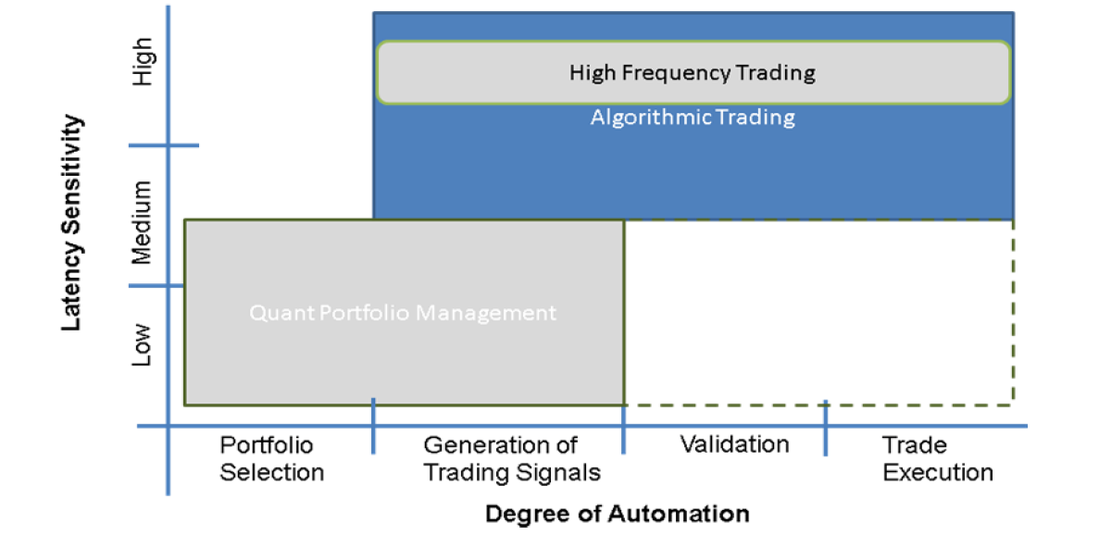
2. HFT Definition (academics)
Gomber, Arndt, Lutat and Uhle (2011)
HFT = quant trading on steroids
© Copyright Irene Aldridge 2012

Slide 18
2. HFT definition (survey)
High-frequency trading comprises of
Systematic,
Quant-based models
With holding periods from a fraction of a second to 1 day (no positions held overnight)
Survey by FINalternatives (July 2009)
300 responses from hedge fund managers who subscribe to FINalternatives (out of 10,000 questionnaires sent out)
About the same time, a prominent multi-billion hedge fund launched an “HFT” fund with an average position holding period of THREE DAYS.

Slide 19
2. HFT Definition (academics 2)
HFT = high market volume, low inventory.
Kirilenko, Kyle, Samadi, Tuzun (2011)
HFT is different from other market participants:
Intermediaries, characterized by low inventory, but not high trading volume
Fundamental buyers, who are consistent net buyers intraday
Fundamental sellers, who are consistent net sellers within a given day
Small traders, generating low volume
Opportunistic traders, loosely defined as all other traders, not fitting the definition of HFT or other categories above
Somewhat arbitrary cut-off figures for low inventory and high volume

Slide 20
2. HFT Definition (broker-dealers)
HFT = trading behavior unattainable by human market participants
often used by brokers to segment their clients into HFT and non-HFT
attribution of trading activity of each specific account into human-feasible and human-infeasible
For example, an account generating 200 orders per second would be deemed HFT

Slide 21
2. Algo Trading and HFT
“Algo execution”
Electronic
Interface
Broker-Dealer
Run-Time Processor
Proprietary software technology
Process real-time quotes
Perform run-time econometrics
Develop buy and sell signals
Calculate run-time P&L,
Risk management based on pre-defined parameters
Generate order and fulfillment record for future reconciliation
Services:
Quotes
Order Processing
Trade Reconciliation
Live Quotes
Archive all quotes received
Buy/Sell Orders
USD/CAD
Human Element
Run-time performance monitoring
Innovation in strategy development/enhancement
Simulation Engine
Proprietary software technology
Generates and tests new strategies
Enhances current trading strategies based on the results generated in the post-trade analysis
Post-Trade Analysis
Proprietary software technology
Reconciles daily trades with simulation results based on archived data
Identifies slippages, anomalies and other discrepancies

Slide 22
Overview of HFT Strategies
2. Overview of HFT Strategies
2.1 Statistical Arbitrage
2.2 Directional Event Trading
2.3 Market Making
2.4 HFT strategies thought to be adverse

Slide 23
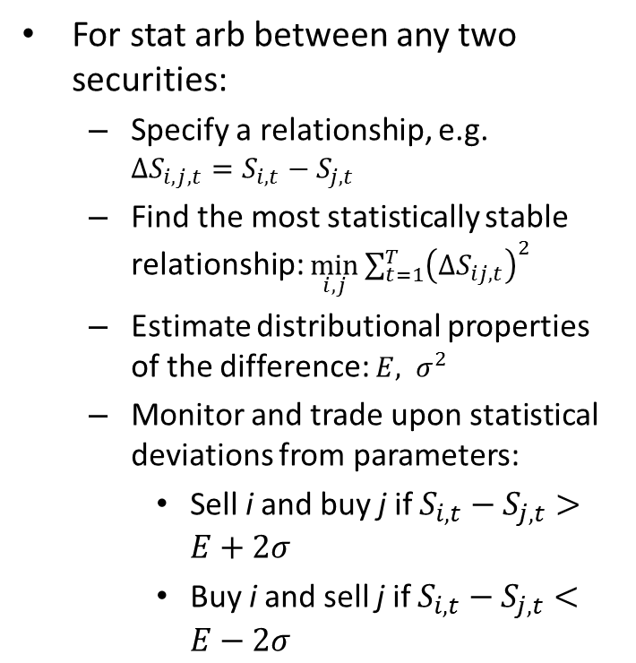
2.1 Mean-reversion = Stat Arb
Definition
Methodology
For stat arb between any two securities:
Specify a relationship, e.g. $ΔS_{i,j,t}=S_{i,t}−S_{j,t}$
Find the most statistically stable relationship: $\min_{i,j}{\sum_{t=1}^{T}{{\left(∆S_{ij,t}\right)}^{2}}}$
Estimate distributional properties of the difference: $E, σ^{2}$
Monitor and trade upon statistical deviations from parameters:
Sell i and buy j if $S_{i,t}−S_{j,t}>E+2σ$
Buy i and sell j if $S_{i,t}−S_{j,t}<E−2σ$
Statistical arbitrage = trading on deviations from persistent statistical phenomena
Notes:
Phenomena can be spurious (the number of sun spots has been shown to influence stock returns)
Main criteria: the statistical phenomenon has to hold with probability of 90% or higher
Stat arb is a statistical enhancement of a technical analysis technique known as Bollinger Bands

Slide 24
2.2 Momentum = Directional event trading
The basics of events
Event arbitrage step-by-step
Definition
An event is a recurrent news that moves the markets
Types of news suitable for event arbitrage
Corporate news
Analysts’ forecasts, earnings releases, a combination of the two (earnings surprises)
Industry news
Legal decisions, regulatory changes, announcements of new products
Macroeconomic news
Government statistics, etc.
To construct event time series, follow a three-step process for event type of interest:
Identify dates and times of past events
Compute historical price changes for securities of interest
Estimate expected price response
Test response “out-of-sample”
Trade upon results

Slide 25
2.3 Market Making 101
Market making is a service
Anyone can make markets
To provide “predictable immediacy” in supply and demand on security exchanges (Demsetz, 1968)
Market makers place limit orders
Patiently wait for customers
Patience has to be compensated
The difference between the limit sell and the limit buy is the compensation of market-makers
Before: market-making was the domain of “specialists”
Introduction of electronic trading facilitated leveling of the playing field
After Reg NMS (2005) anyone can be a market-maker in equities
Brokers and exchanges are obligated to display best quotes
Most exchanges provide free registration for market makers

Slide 26
2.3 Market Making 102
Market-Making is risky
Solutions for Automated MM
Inventory risk
A large inventory position may be difficult to liquidate in case of an adverse market move
Risk of information asymmetry
Counterparty has better information than the market-maker
Counterparty can “pick over” the market maker
Inventory models:
Start with a “sweet spot” inventory
Adjust the inventory according to the current market conditions
Information models
Allow pick-over:
Make money on liquidity demanders, lose money to better-informed traders, Amihud and Mendelson (1980)
Use exchange rebates
Build information into market-making models to minimize pick-over

Slide 27
2.4 HFT strategies thought to be adverse
Strategies
Source
2.4.1 Rebate capture
2.4.2 Quote matching
2.4.3 Layering
2.4.4 Ignition
2.4.5 Pinging/sniping/sniffing
2.4.6 Quote stuffing
2.4.7 Spoofing
Strategy list from CFTC subcommittee on HFT

Slide 28
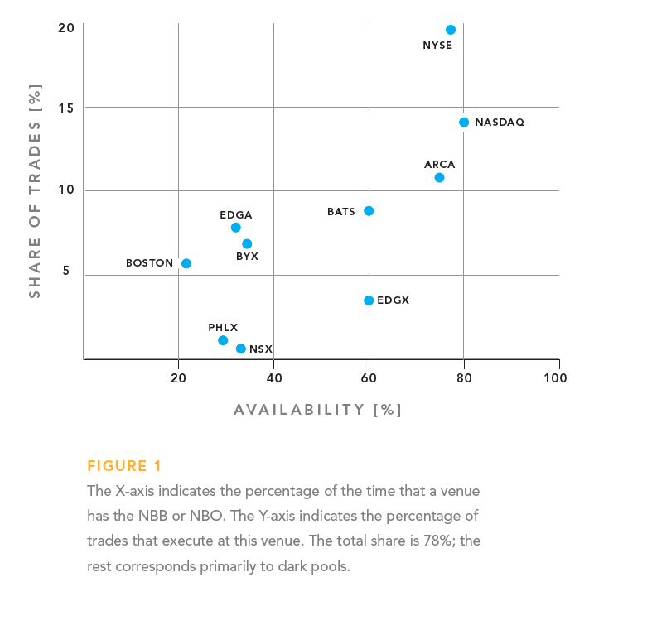
2.4 HFT strategies thought to be adverse
2.4.1 Rebate capture
Arbitrage equity exchange rebates:
Place limit orders, collect rebates
Critics: economic value?
Proponents: rebates are integral parts of exchange business models
The strategy is likely not feasible:
Pure alpha generation via “Rebate scalping” is yet to be shown
Considerable risks exist
Risk of non-execution
Risk of adverse selection

Slide 29
2.4 HFT strategies thought to be adverse
2.4.2 Quote matching
2.4.3 Layering
A strategy that mimics that of another liquidity provider
Place limit orders next to others’ limit orders
Critics: dilutes profitability of market-makers
Seeks to minimize or share risks associated with liquidity provision
Is the strategy feasible in lit markets?
Most lit markets are anonymous
Cannot track orders placed by one entity
Can copying EVERY limit order be profitable?
What about time delay?
Leaves “placeholder” limit orders with the intent of securing early execution in each price queue in the limit order book
Used when order books are executed in the time-price-priority sequence
Limit orders can be cancelled
Critics: strategy generates noise in markets
Reality:
Strategy is real
Many markets move away to pro-rata matching to make layering unnecessary (e.g., CME)

Slide 30
2.4 HFT strategies thought to be adverse
2.4.4 Ignition
2.4.5 Pinging/sniping/sniffing
Estimate location of stop orders
Cause stop orders to execute
Not feasible in lit markets
Cannot trigger orders “behind the market”
Have to trade through the best bid/ask first
A trader estimates liquidity available at given price points
Showing small orders
Gauge immediacy and scale of response
Arbitrage pockets of liquidity
This strategy is feasible dark pools
Some dark pools (Citi ATD) monitor and charge for such behavior
Not feasible in lit markets
Concentration of stop losses
Best bid
Best ask = best offer
Bid-ask spread
price

Slide 31
2.4 HFT strategies thought to be adverse
2.4.6 Quote stuffing
2.4.7 Spoofing
Intentional “clogging” of networks with the objective of slowing down other traders
Most often, a result of layering
Clogging of networks cannot be selective:
Will slow down the quote stuffing trader as well
What is the point?
Can only be profitable for low-frequency traders
Identical to layering in implementation; key difference is intent:
spoofing refers to intent of distorting the order book
changing other investors’ inferences about available supply and demand
Illegal under Dodd-Frank
Actively prosecuted (Bunge case, 2011, CFTC, $550,000 penalty)

Slide 32
2.4 HFT strategies thought to be adverse
2.4 Summary
Strategy Summary:
2.4.1 Rebate capture
Risky, hard to make money
2.4.2 Quote matching
Infeasible in pro-rata markets
2.4.3 Layering
Pointless in pro-rata markets
2.4.4 Ignition
Infeasible in lit markets
2.4.5 Pinging/sniping/sniffing
Infeasible in lit markets
2.4.6 Quote stuffing
No point, unless executed by a low-frequency trader
2.4.7 Spoofing
Illegal under Dodd-Frank
Most strategies thought to be “bad” HFT are not feasible in today’s lit markets
Potentially feasible in dark pools
Dark pools are operated under “buyer beware” principle

Slide 33
2. Algo execution
Definitions
An ideal algo
Algo execution = “smart order routing”
Eleven common algos in the “toolkit” of every broker-dealer
Help traders navigate costs, market conditions
Economics:
Improve investor return or alpha
Cost investors a fraction of the obtained price improvement
Given a period of time,
Produce the best possible pricing
Within customer risk specifications
Accounting for customer’s cost structure

Slide 34
2. Algo Implementation
Ideas
Tools
Data
Academic research and proprietary extensions
Advanced econometric modeling: MatLab, R, Julia with custom libraries.
C++ or Java is necessary for back tests and transition into production.
Computer “horsepower”
FIX, FAST, ITCH, OUCH
Fast databases: KX, column-oriented stuff
Tick data
Most informative
Market depth
Necessary for the highest-frequency strategies, liquidity provision.
Desirable for market microstructure strategies.
Real-time streaming data
Broker-dealer data
Reference data (eg, Reuters)
Data wrappers: RealTick (latency 250-1000 ms), Spryware (latency 200ms)
© Copyright Irene Aldridge 2012

Slide 35
The business of HFT
Outline:
History of trading
What is HFT?
Realities of modern trading

Slide 36
3. Realities of Modern Trading
The old times
The new times
4 quotes per day:
Open
High
Low
Close
Take 20,000 quotes in the S&P 500 ETF (SPY)
How many hours do these quotes cover?

Slide 37
3. What is the average speed of quotes?
How many quotes are there per unit of time?
How many distinct signals can human eye interpret?
In intraday trading, the choice is clear: HAVE to use algorithms
In longer-horizon trading, daily data and manual analysis may still suffice

Slide 38
3. Algorithms in recent research
Investors automate their trading (Hendershott and Riordan, 2009)
Most markets are electronic limit order books (Jain, 2005)
Use of trading algorithms is on the rise;
Automate trading decisions
Submit orders
Manage orders post-submission
Both buy-side and sell-side engage in high-frequency trading
Sell-side must understand buy-side trading strategies to avoid being picked off

Slide 39
3. Algorithms
Two types:
High-frequency trading: arbitrage of intraday market inefficiencies
Includes market-making
Order-splitting facilitation of execution
To minimize market impact, associated costs
All algorithms initiate an increasing proportion of trades
In January 2008 on Deutsche Borse (according to Henderschott and Riordan, 2010):
Algorithms initiated 52% of trading volume: 68% of all trades of less than 500 shares, 23% of all trades of 10,000 or more
Algorithms are observed to cluster their trades close to one another.
Algos are more sensitive to trades initiated by human traders than human traders are to algos.
Algos are less likely to initiate trades following high market volume.
Algos’ behavior does not change following high volatility conditions.
Human trading generates most noise in foreign exchange trading (Chaboud et al., 2009)

Slide 40
3. Algorithmic Trades Carry Information
Algo-initiated market orders carry 20% larger permanent price impact than do human trades
Human trades are more likely to be random relative to realized prices that follow
Algo trades impound 40% more information than do human trades
Yet, algorithms are better at disguising their trading intentions.
Algos are more likely to initiate trades when liquidity is high (higher depth and narrower bid-ask spreads)
Algo-initiated limit orders are at the best price more often than human limit orders
In normal market conditions, algos supplied 50% of Deutsche Borse DAX liquidity in January 2008
When liquidity is lower, algorithms supplied more liquidity than humans
Humans withdrew liquidity more often than algos
Algos consume liquidity when cheap and supply liquidity when it is expensive, smoothing liquidity over time.

Slide 41
3. Execution algorithms lower costs
Different algorithms deliver different execution costs (Domowitz and Yegerman, 2005).
Algorithm aggressiveness impacts execution costs (Engle, Russell, and Ferstenberg, 2007).
Can be used by traders to accumulate or liquidate a large position by breaking up orders into pieces
Execution algos select
Timing of order parcels
Size of each parcel
Level of aggressiveness
Ranging from market orders (most aggressive)
To stub quotes (most passive)
To avoid being “picked off” algos cancel many limit orders when they fail to execute
The orders are often resubmitted almost immediately at a price closer to market

Slide 42
3. Theory vs. Reality of Trading
Theory
Reality
3.1 Markets are perfect!
3.2 Markets immediately reflect all fundamental information
3.3 Markets are uniform
3.4 Markets are consolidated
3.1 Markets have “frictions”
3.2 Markets incorporate and leak information over time
3.3 Markets differ wildly
3.4 Markets are highly fragmented

Slide 43
3.1 Market imperfections
Financial Theory
Trading Practice
No “market frictions:”
No transaction costs
Can execute as big or as little position at the market price (unlimited depth)
Unlimited borrowing power at the risk free rate
No short-sale constraints
Market price is invariant to the order size
3.1.1 Various transaction costs
3.1.2 Finite market depth
3.1.3 Market price subject to market impact
Optimal algo execution helps navigate imperfections;
HFT exploits imperfections to deliver return = alpha

Slide 44
3.1.1 Transaction costs
Transparent costs
Latent costs
Broker commissions
Fixed (per order, per month)
Variable (per trade size)
Leverage costs
Exchange fees
Taxes
Bid-ask spread
Slippage
Opportunity Cost

Slide 45
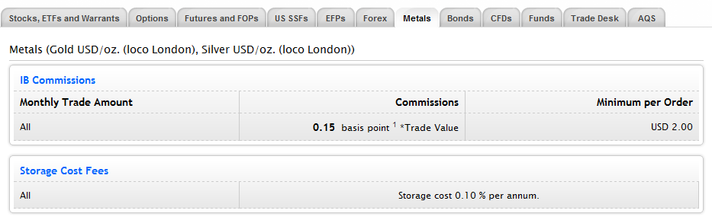
3.1.1.1 Broker commissions
Fixed Commissions
Variable Commissions
Minimum per order
Minimum per month
Leverage
Financing charges
Amount per trade size (contract or share)
Amount per trade value
Amount per monthly volume
Example: Interactive Brokers

Slide 46
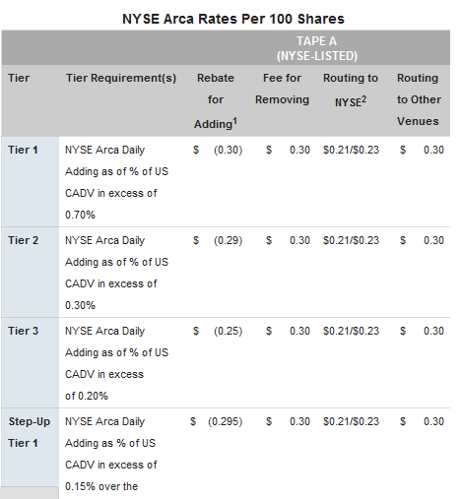
3.1.1.2 Exchange fees
Exchange fees
Example: NYSE Arca
Can be positive and negative
Positive fees:
Charged for removing liquidity = sending a market order
Negative fees (rebates):
Provided for adding liquidity (posting limit orders)
Additional fees charged for:
Special types of orders (e.g., MPL order on NYSE is a limit order that is not displayed)
Algo routing to a liquidity source

Slide 47
3.1.1.3 Taxes
Income taxes
Transaction taxes
Regular income tax
Imposed on all investment activity with less than 1 year horizon
Can deduct all expenses that helped materialize the income
Capital gains tax
Charged on investments held for 1 year or longer
About 50% of the regular income tax
A.k.a. Tobin tax
First proposed by Tobin in 1978
To curb speculation in foreign exchange
Most recently introduced in E.U. parliament to finance deficit
The risk of tax introduction exists, but:
Implementation is difficult -- requires international cooperation
Negative experience of countries that have implemented the tax in the past
Likely to kill economic growth (Aldridge, 2012, “The Consequences of Transaction Taxes: An Empirical Analysis“)

Slide 48
3.1.1.4 Bid-ask spread
Definitions
Example, EUR/USD
= best ask price – best bid price
The cost of instantaneous position reversal
Premium on immediacy/market orders
Traders desiring to fill their orders ASAP pay the bid-ask spread
Compensation for market-making/limit orders
Traders patiently willing to wait to execute charge the bid-ask spread
Reflects uncertainty in the markets
Average hourly bid-ask spread on EUR/USD spot for the last two weeks of October 2008 on a median transaction size of USD 5 million.
Spread on the weekend of Oct 18, 2008 – Oct 19, 2008

Slide 49
3.1.1.5 Slippage and 3.1.1.6 Opportunity cost
Slippage
Opportunity cost
The difference between the observed pre-order quote and the realized market price
The price “slips” due to contemporaneous arrival of new orders
Slippage is typically worst during periods of high trading activity
News announcements
Market open
Market close
Return that could have been realized with the capital invested elsewhere

Slide 50
3.1.2 Finite market depth
Definitions
Example
When a large market order arrives and “top of the book” liquidity is exhausted
The market order “sweeps” the book
Most modern exchanges are organized as “limit order books”
When a new limit order arrives, it is placed in a limit order bin corresponding to its price
At each price, there is a finite aggregate liquidity = sum of limit order sizes
Best bid
Best ask = best offer
Bid-ask spread
price
A large market sell order
sweeps the bids in the book,
realizes lower aggregate price,
changes best bid
price

Slide 51
3.1.3 Market impact
Theory
Theory
price
In the idealized financial world:
Everyone interprets all information in the same way
Only fundamentals affect prices
As a result, a sharp step function in prices immediately following a fundamental news
time
A market buy order carrying fundamental info arrives here
price
time
A market buy order without fundamental information arrives here

Slide 52
3.1.3 Market impact
Reality
Reality
Temporary
Market Impact
price
Traders have different interpretation of news
Long-term and short-term opinions often differ
Implication: short-term traders do not eat long-term traders’ lunch;
Short-term traders reduce LT volatility instead
Markets deviate from theory
time
A market buy order carrying fundamental info arrives here
price
Temporary
Market impact
time
A market buy order without fundamental information arrives here

Slide 53
3.1.3 The cost of market impact
In equities, the ITG’s Global Trading Cost Review (2010) reported:
The average cost of an equities trade in the U.S. in the first quarter of 2010 was 0.476%,
0.089% was spent on commissions
the remaining 0.387% were due to market impact (the numbers were comparable to those in the E.U., the U.K., and Japan; emerging markets posted higher costs).

Slide 54
3.1.3 Market impact
Measuring market impact
Studies
Both pre-trade and post-trade market impact matter
Pre-trade impact can be due to:
Anticipation of a market order
algos often “slice” a large order into a predictable sequence of small orders
limit orders of opposite direction
Pre-trade impact ~ 25% of post-trade impact
NASDAQ: Hautsch and Huang (2011)
EUREX: Aldridge (2012)
Event: Incoming market order,
either a buy or a sell
Trade resulting from order execution
Last trade prior to the order
Previous trade(s)
t-2
t-1
t*
t
Pre-trade impact
Post-trade impact
© Copyright Irene Aldridge 2012

Slide 55
3.2 Information leakage
Trades “Leak” Information
Information affecting prices
Market-makers (“specialists”) observe market activity
Learn information content
Adjust quoted prices
Prices reflect the expectation of security terminal value
Net Present Value (NPV) of future cash flows
Conditional on all public information, including prior trades
Price adjustment is gradual
Short-run effect
Long-run effect
Hasbrouck (1991)
News
Macroeconomic releases
Corporate earnings
Political news
…
Trade prices
Trade sizes
Best bid/best offer quotes
Best bid/best offer sizes
Shape of the order book
Duration between trades
Duration between quote “arrival”
Endogenous dynamic between short-term price movements and other market microstructure variables.
Optimal execution algo navigates these issues.
© Copyright Irene Aldridge 2012

Slide 56
3.3 Market con/divergence
Convergence
Divergence
Most markets can be accessed via FIX
Most markets worldwide are based on limit order book model
Many trading venues charge for market orders (taking away liquidity) and pay for limit orders (providing liquidity)
Equities are subject to Reg NMS rules
All market equity orders must be executed at the National Best Bid/Offer (NBBO)
Exchanges that cannot match NBBO must pass the orders on to other venues
Futures have margining requirements
Foreign exchange does not have centralized quotes or exchanges
Options have so many products, that very few investors can keep track of them all
As a result, options markets are highly transparent
© Copyright Irene Aldridge 2012

Slide 57
3.4 Market fragmentation
Exchange Competition
Example
Falling costs of technology allowed multiple start-ups in the exchange field
Exchanges attempt to differentiate themselves with cost structures and other variables
Source: Pragma Securities, “Inverted-Price Destinations and Smart Order Routing”
© Copyright Irene Aldridge 2012

Slide 58
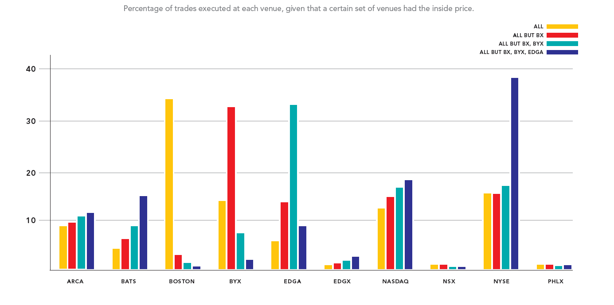
3.4 Market fragmentation
Source: Pragma Securities, “Inverted-Price Destinations and Smart Order Routing”

Slide 59
Summary
Markets are electronic
Need electronic tools to work with markets up close
Algorithms are here to stay
HFT (a subset of algo trading) is here to stay as well
Various strategies to explore later today

